Slide 1

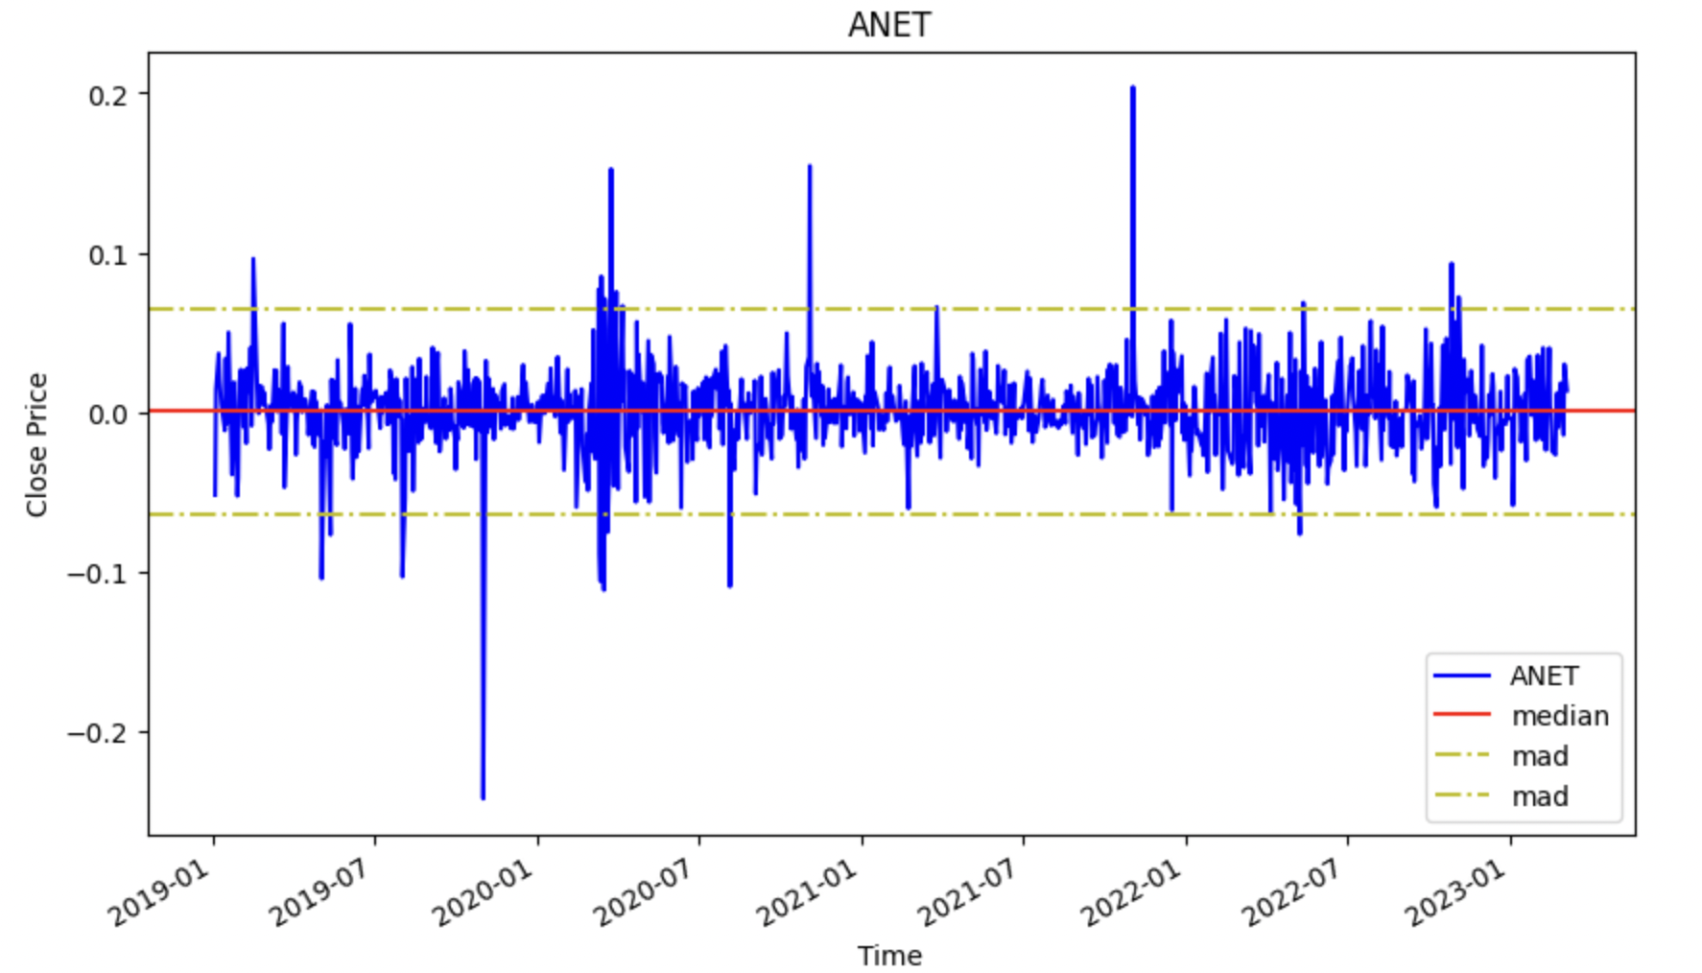


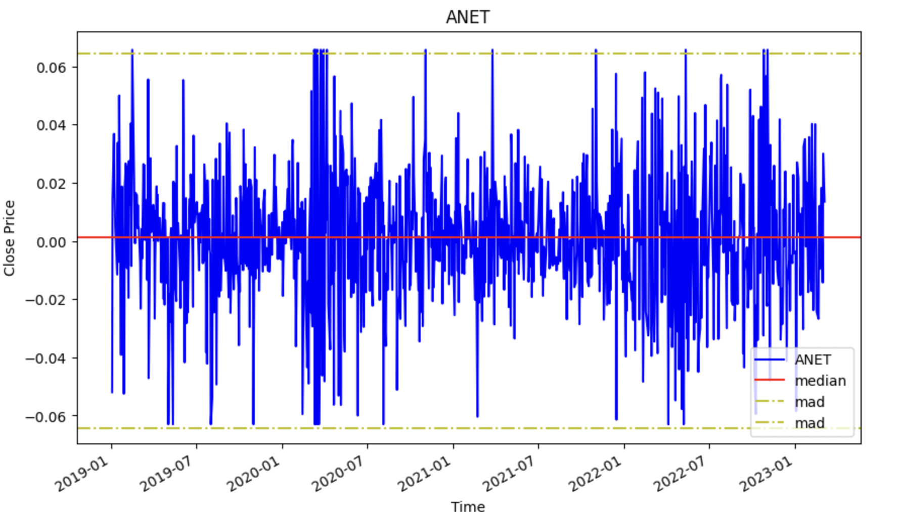
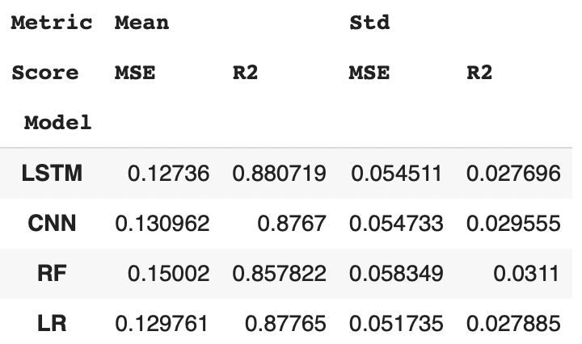
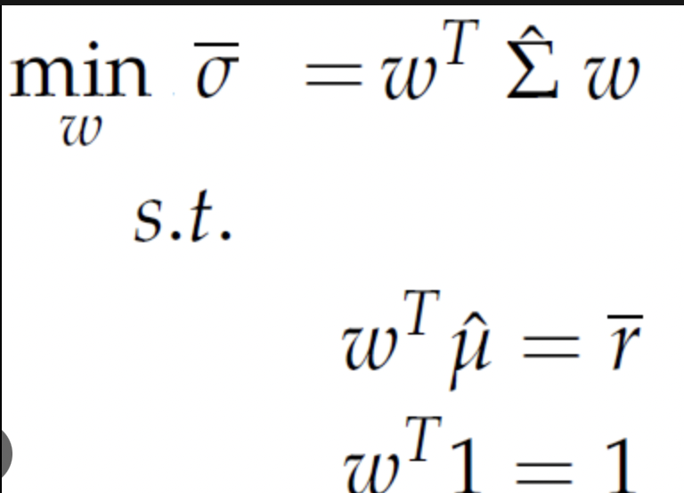
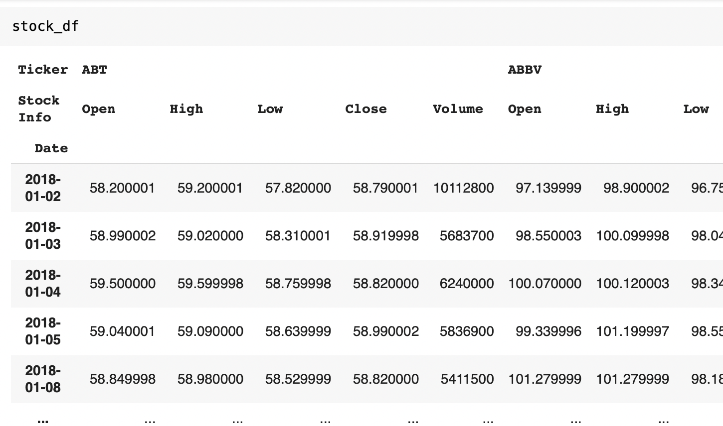
Portfolio Optimization and Stock Returns Prediction Using Neural Networks and Supervised Models: Comparative Study of LSTM, CNN, RF, LR Models
Aigerim Mansurova
Pace University, Seidenberg School of CSIS
Results
The growth of prices before removing extra high and low values
Conclusion and Future works
This project applies two DNN and two supervised learning models to predict returns of stocks listed in S&P 500 index. The best-performing model is chosen by comparing the mean and standard deviation of evaluation metrics (MSE and R^2). LSTM, which is a frequently used DNN model that has been shown to have better learning abilities than traditional ML models, has a mean MSE of 0.13 and a mean R^2 of 0.88. Portfolio is constructed by top five stocks, having the highest average returns, from each sectors. Mean-variance optimization technique is utilized to calculate the optimal stock weights allocation. Expected annual returns of portfolio is calculated using two different methods: optimal weights obtained from applying MVO technique and equal weights. The return from equal weights is 7.3%, while the return from optimal weights is 17.52%.
The performance of models could be improved by adding new features such as economic, financial indicators and applying NLP by considering news headlines. Additionally, there might be other optimization techniques other than mean-variance optimization model. Future research could expand the input features and utilize superior risk metrics to construct prediction-based portfolio models, improving their out-of-sample performance.
References
Y. Ma, R. Han , W. Wang: Prediction-Based Portfolio Optimization Models Using Deep Neural Networks, IEEE Xplore Digital Library: 10.1109/ACCESS.2020.3003819
Van-Dai Ta, Chuan-Ming Liu, Direselign Addis Tadesse: Portfolio Optimization-Based Stock Prediction Using Long-Short Term Memory Network in Quantitative Trading, Applied Science
T. Fischer and C. Krauss: Deep learning with long short-term memory networks for financial market predictions,’ Eur. J. Oper. Res., vol. 270, no. 2, pp. 654–669, Oct. 2018.
W. Wang, W. Li, N. Zhang, K. Liu: Portfolio formation with preselection using deep learning from long-term financial data, Expert Syst. Appl., vol. 143, Apr. 2020, Art. no. 113042.
A. J. P. Samarawickrama, T. G. I. Fernando: A recurrent neural
network approach in predicting daily stock prices an application to the Sri Lankan stock market, in Proc. IEEE Int. Conf. Ind. Inf. Syst. (ICIIS), Dec. 2017, pp. 1–6.
Abstract
Methodology
Data Preprocessing This project applies past 20 days’ daily growth of open, close, high, low price and volumes, having a dimension of input for each prediction as 20x5, to predict next day’s return. Growth is calculated by the formula:
where p(t) is current price,
p(t-1) – last day’s price.
Extra high and low values are detected as follows:
where dm is median of each feature (di); dmm - median absolute deviation. Then, data is standardized. Sliding window is used, i.e., the first 2 years data is training set, following 1 year is validation and data from 01-01-2022 to 04.10.2023 is testing set.
Modeling Four different models (LSTM, CNN, RF, LR) are used to see the testing score and say which one performs best. This experiment applies mean-squared error and R-squared as model performance metrics.
Portfolio Optimization Model
Based on the averages of predicted returns, the top 5 stocks from each sectors are selected to form diversified portfolio. Portfolio allocation is then performed using mean-variance optimization technique. Mean-variance method aims to find optimal weights to maximize the expected return of portfolio for a given level of risk aversion using following formula:
A higher value of risk aversion implies that the investor is more risk-averse and would require a higher expected return to compensate for the additional risk.
 | Equal weights | Optimal weights
Expected annual return of portfolio | 7.3% | 17.52%
Predicting stock returns using Deep Neural Network (DNN) and Supervised Learning models is in high demand nowadays because it has the potential to provide more accurate and reliable information. In this project, long short-term memory (LSTM) neural network, convolutional neural network (CNN), Random Forest (RF) and Linear Regression (LR) models are employed to predict returns of stocks listed in S&P 500. Then, mean-variance optimization model is applied to calculate optimal weights of stocks in a predication-based portfolio.
Research Questions
Which forecasting model performs the best in predicting the returns of stocks?
How can optimization technique be used to determine the optimal allocation of assets in a portfolio for maximum return and minimal risk?
Related Work
Several studies have explored the use of deep learning techniques for portfolio optimization and stock prediction in the financial market [Y. Ma, R. Han , W. Wang, 2020]. [Fischer, Krauss, 2018] used long short-term memory networks for financial market predictions, and [Wang, 2020] presented a deep learning approach for portfolio formation with preselection using long-term financial data.
Dataset
5-year daily historical stock prices of major four Sectors (Energy, Financials, IT, Health Care), listed in S&P 500, are collected from Yahoo Finance API from 01.01. 2018 to 04.10.2023. For each stock, daily ‘Open’, ‘Close’, ’Low’, ‘High’ prices and trading volume were used as the main input values in the dataset. Overall, the shape of the dataset is 1305 rows by 1060 columns.
LSTM has the lowest mean of MSE and highest one of R^2 compared to the other models’, and although their standard deviations are not the lowest, their difference is relatively small. On the other hand, Linear Regression’s mean and standard deviations of model performance metrics shows a good result, which means supervised learning model can be also used as a predictor of returns. Nevertheless, LSTM is a superior model in stock returns prediction.
Thus, predicted returns by LSTM models are selected to construct a portfolio.

